Slide 1
Maya Gans
Mayacelium
MayaGans

Slide 2
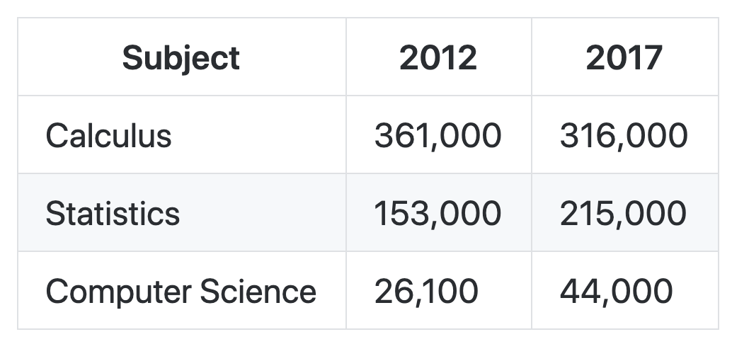
AP STATISTICS

Slide 3
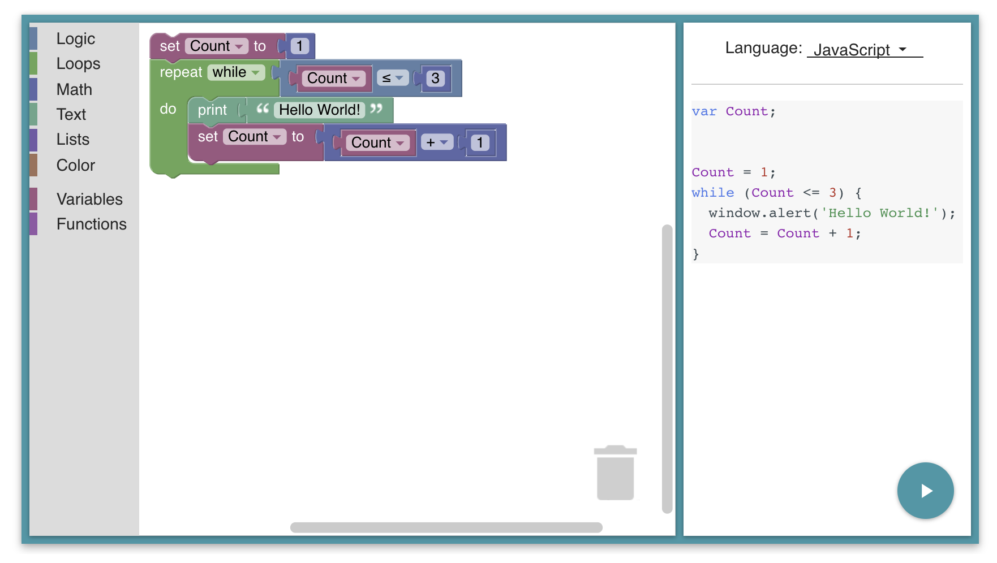
BLOCKS vs TEXT

Slide 4
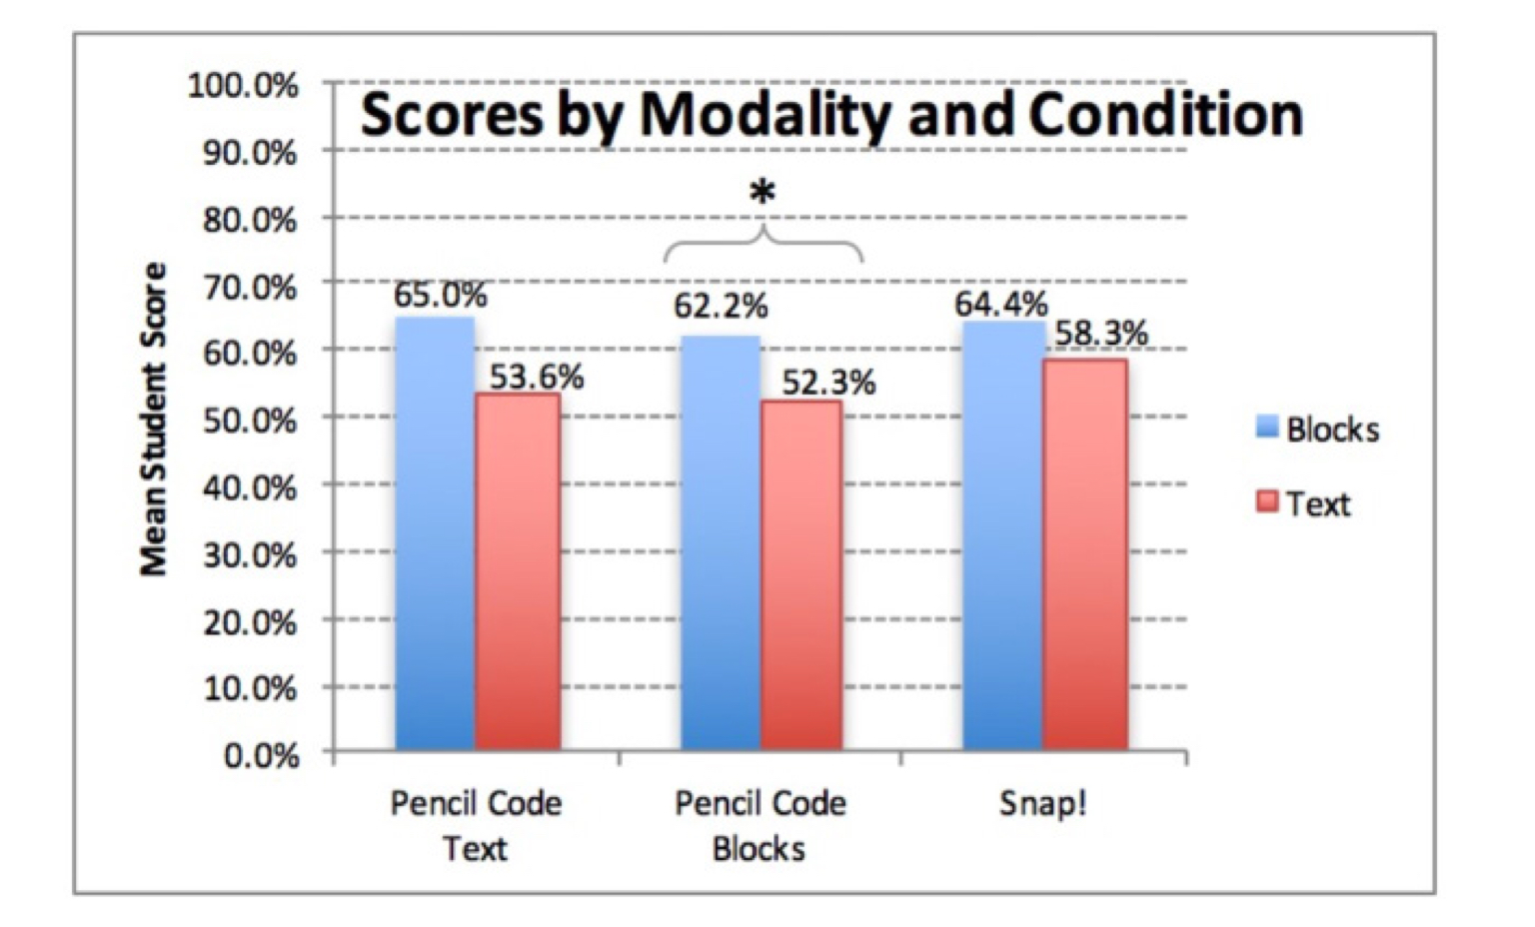
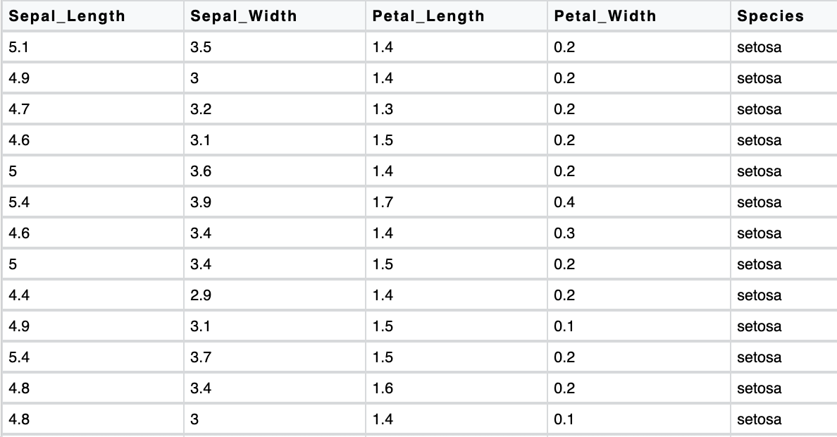
CURRENT LIMITATIONS
Weintrop & Wilensky 2017

Slide 5
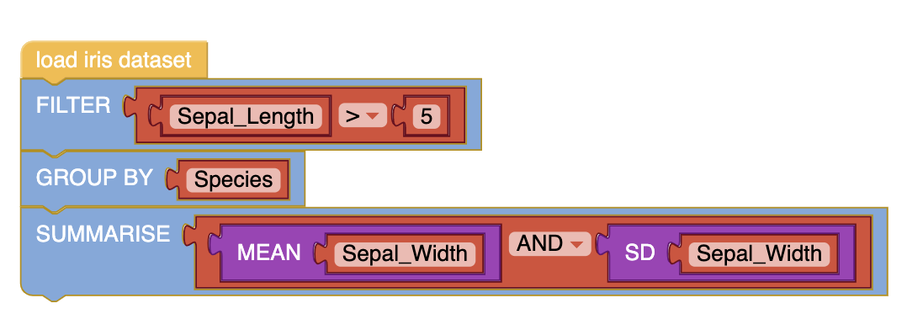
FROM TIDYVERSE TO BLOCKS
iris %>%
filter(Sepal_Length > 5) %>%
group_by(Species) %>%
Summarise(mean = mean(Sepal_Width),
sd = sd(Sepal_Width))

Slide 6
THE FUTURE
maya@rstudio.com

